Slide 1
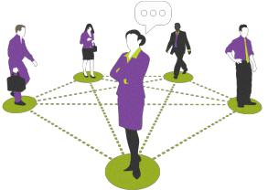


Networking
Class X
lab 22

Slide 2
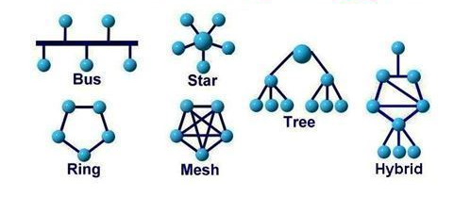
Network Topology
Network Topology is the arrangement with which computer systems or network devices are connected to each other

Slide 3

Point-to-Point
Point-to-point networks contains exactly two hosts

Slide 4
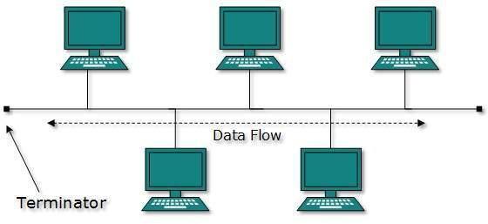
Bus Topology
all devices share single communication line or cable

Slide 5
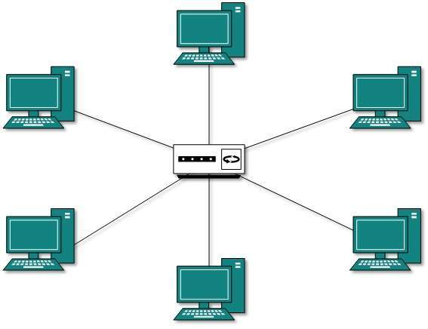
Star Topology
All hosts in Star topology are connected to a central device

Slide 6
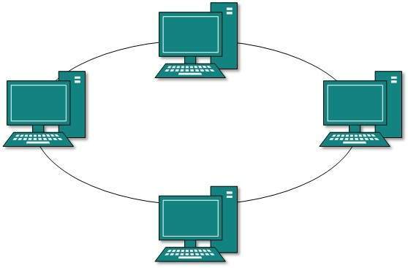
Ring Topology
each host machine connects to exactly two other machines, creating a circular network structure

Slide 7
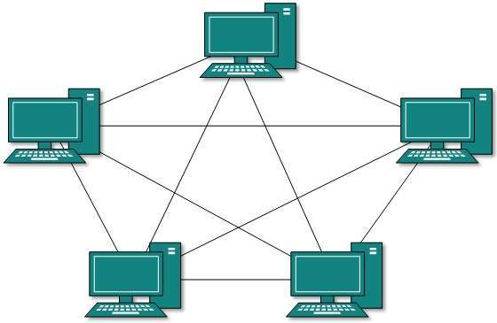
Mesh Topology
a host is connected to one or multiple hosts

Slide 8
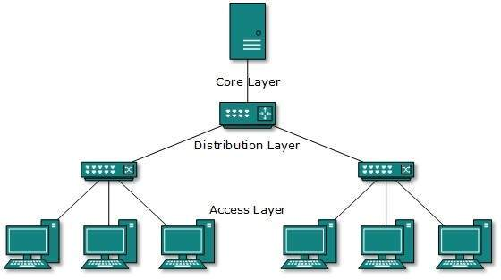
Tree Topology
This topology imitates as extended Star topology and inherits properties of bus topology

Slide 9
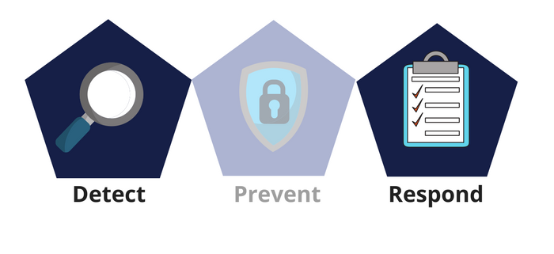

Thank You

